Slide 1
Online reservation system
Name: Lakshmi Lavanya
Batch no: 2022-7601
Enrolment No: EBEON0722629242

Slide 2
Abstract
Through this Online Reservation System , a practical approach has been taken under study to understand how online reservation system works. This Online Reservation System will include all the necessary fields which are required during online reservation system.
This Reservation System will be easy to use and can be used by any person. The basic idea behind this project is to save data in a central database which can be accessed by any authorize person to get information and saves time and burden which are being faced by their customers.

Slide 3
Proposed System
Through this system customers do not have to wait in line and they will able to get their answers in just a click. Through this system online form will be available by which passengers will able to fill their details along with their journey details.
To book their seats, users will have to first search their trains as per their requirements and after getting correct train they will have to provide Train number. After pressing next button, it will show its status, whether it has been activated or in process.
Online cancellation form will also be available and to cancel their reservation, they will have to provide their PNR number again to carry the next task.

Slide 4
Modules
Login Form.
Reservation Form.
Cancellation Form.
PNR Enquiry.
Exit.

Slide 5
System Requirements
Operating System : Windows XP/2003 or Higher Version of Windows OS.
User Interface : Java Swing.
Programming Language : JDBC, Core Java.
Front-End : HTML, CSS,JS.
IDE/Workbench : Net beans 7.2.
Database : SQL

Slide 6
Description of Modules
Login Form – To access this Online Reservation System, each user should have a valid login id and password. After providing the correct login id and password, users will able to access the main system.
Reservation System – Under reservation form users will have to fill the necessary details such as their basic details, train number, train name will automatically come in the box, class type, date of journey, from (place) to destination and after that, users will have to press insert button.
Cancellation Form – If passengers want to cancel their tickets then they have to provide their PNR number and after submitting it, this will display the entire information related to that particular PNR number. If users want to confirm their cancellation, in this case they have to press OK button.

Slide 7
Technologies Used
JAVA
Java is an object-oriented programming language that produces software for multiple platforms. When a programmer writes a Java application, the compiled code (known as bytecode) runs on most operating systems (OS), including Windows, Linux and Mac OS.
SQL
SQL stands for Structured Query Language. SQL lets you access and manipulate databases. SQL became a standard of the American National Standards Institute (ANSI) in 1986, and of the International Organization for Standardization (ISO) in 1987.
JDBC
Java™ database connectivity (JDBC) is the JavaSoft specification of a standard application programming interface (API) that allows Java programs to access database management systems. The JDBC API consists of a set of interfaces and classes written in the Java programming language.

Slide 8
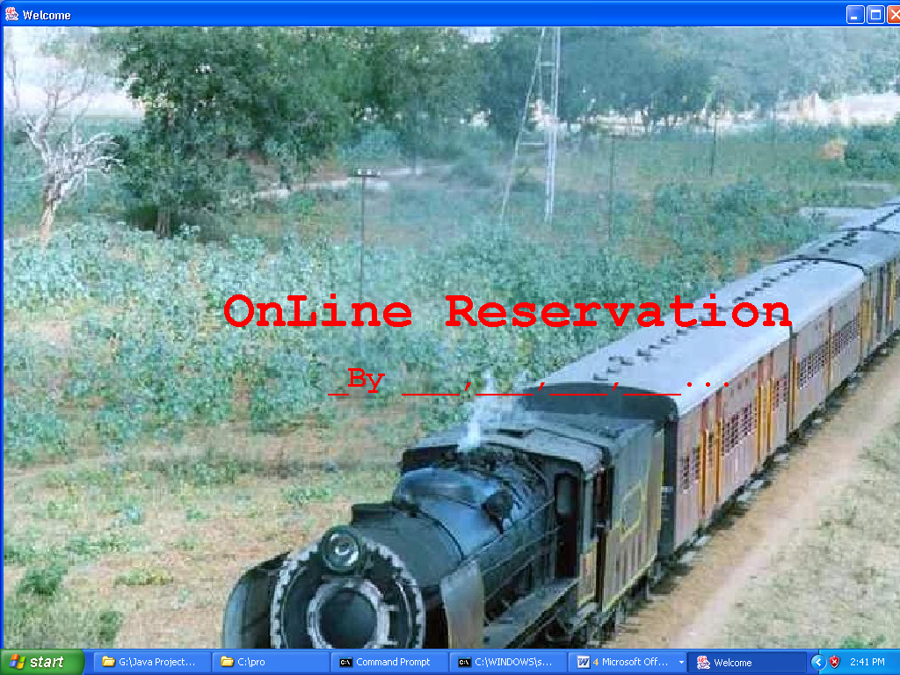
Output Screens
WELCOME SCREEN

Slide 9
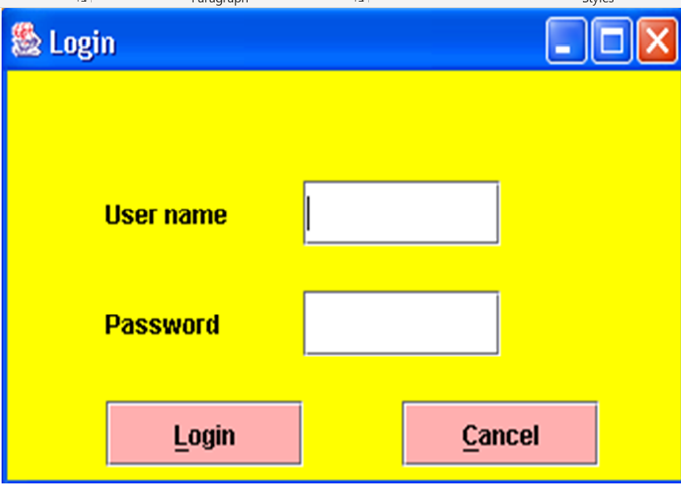
Login Form

Slide 10
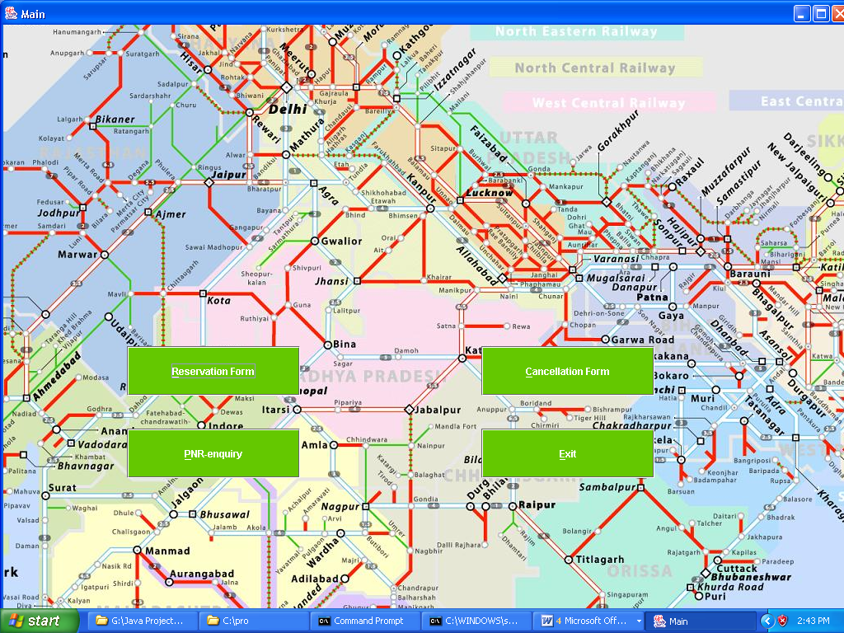
Main Screen

Slide 11
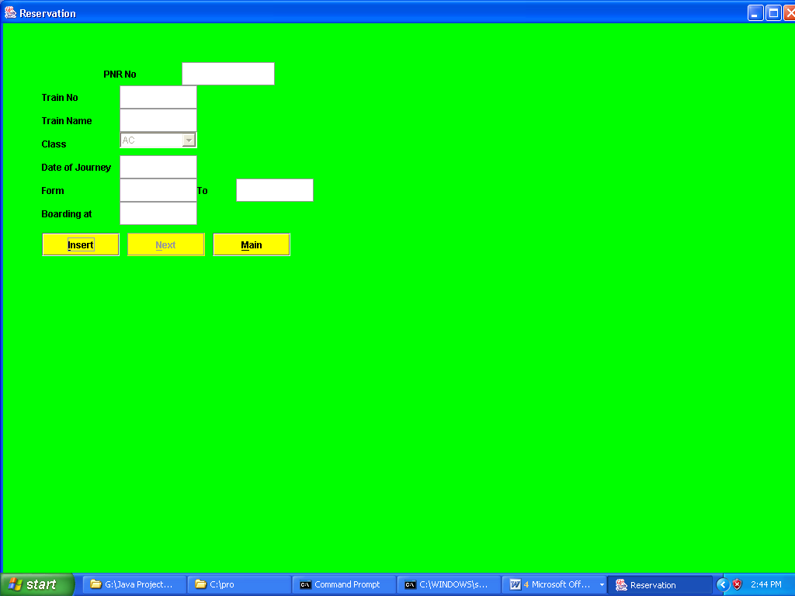
Reservation form

Slide 12
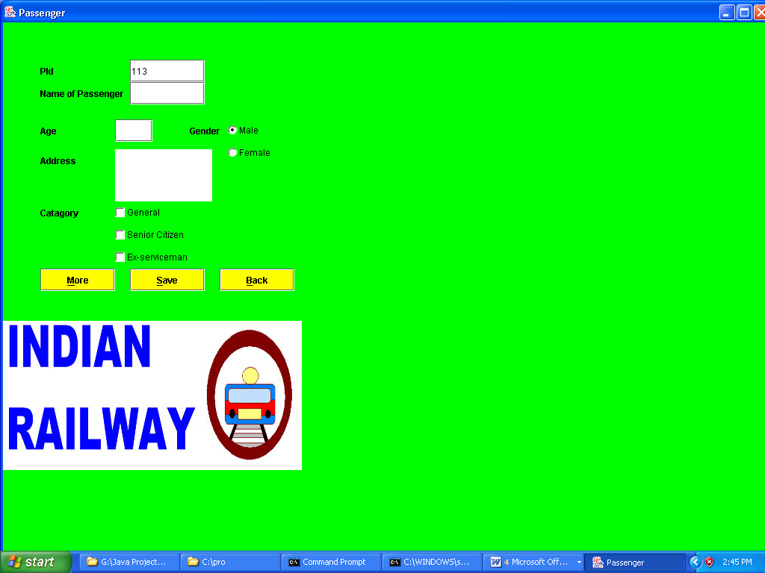
Passenger form

Slide 13
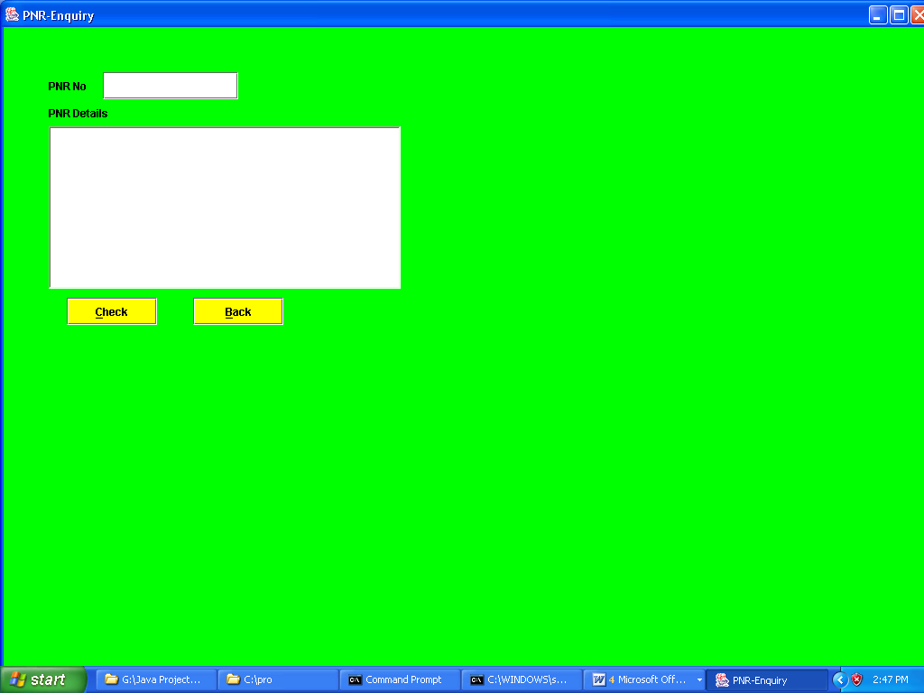
Enquiry Form

Slide 14
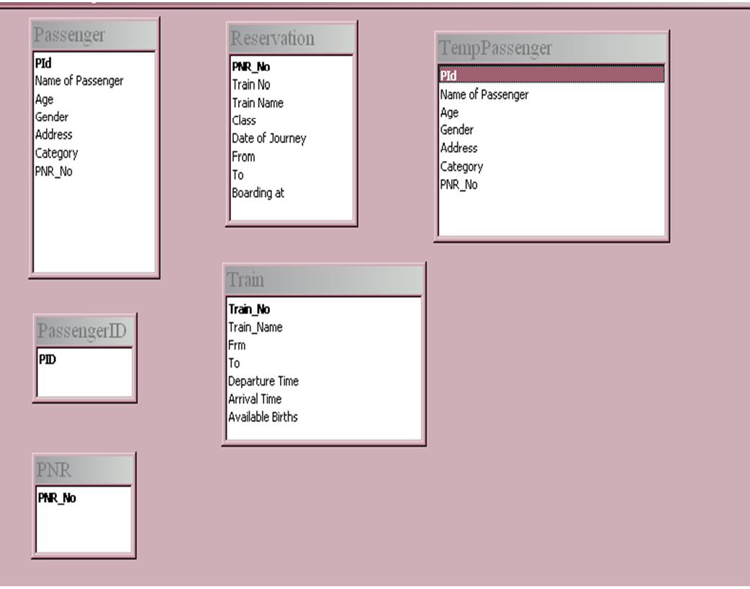
Database Layout

Slide 15
conclusion
Online ticket booking system is very big to maintain but it always provides excellent facilities to accomplish the goal and help to reduce a complex paperwork process through a mobile application. This can be a benefit using online ticket booking system application rather searching on several websites.
With the help of online ticket booking system records are maintained and the database is updated with time to time. Through Online ticket booking system , technologies and features have been introduced.

Slide 16
Thank you

